Slide 1
Leemann & Baccini
1995 – 2010
8 Votes excl. Nuclear Votes
Income: Fixed means
Disaster: only medium and high
Risk: flood, are etc.
Education: Tert Sekund & Tertiary
Keel
1995 – 2023
19 votes incl. 2x Nuclear votes
Income: accurate, yearly
Disaster: low, medium and high (updated data 1995-2010 and new 2011-2023 from provider)
Risk: taken from leemann & baccini
Education: taken from leemann & baccini (accurate data required from stats office)
Age: accurate per year and municipality
Religion: Was in the Age-Dataset so was taken into consideration
Gender: Per Municipality in share and coded as 0(male), 1(female)

Slide 2
Main finding: In comparison
The main finding of Leemann & Baccini was that if municipalities were affected by a natural disaster the yes vote share for environmental votes would go up by 20%. (actually 22.7%)
With the more accurate and expanded data, also by taking in the 2 nuclear votes and recoding them, I get a positve effect of 3.13%
more detailed data and more votes:
Average Effect of Treatment overall: 7.10% | (3.13/44.08)*100 (44.08% average yes of the 19 votes)

Slide 3
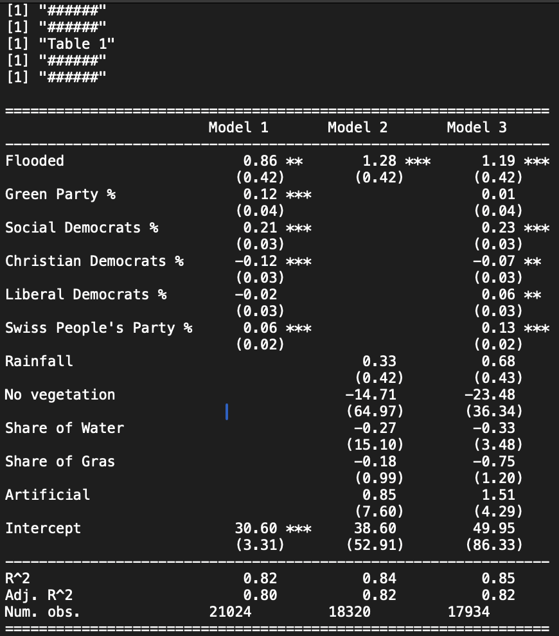
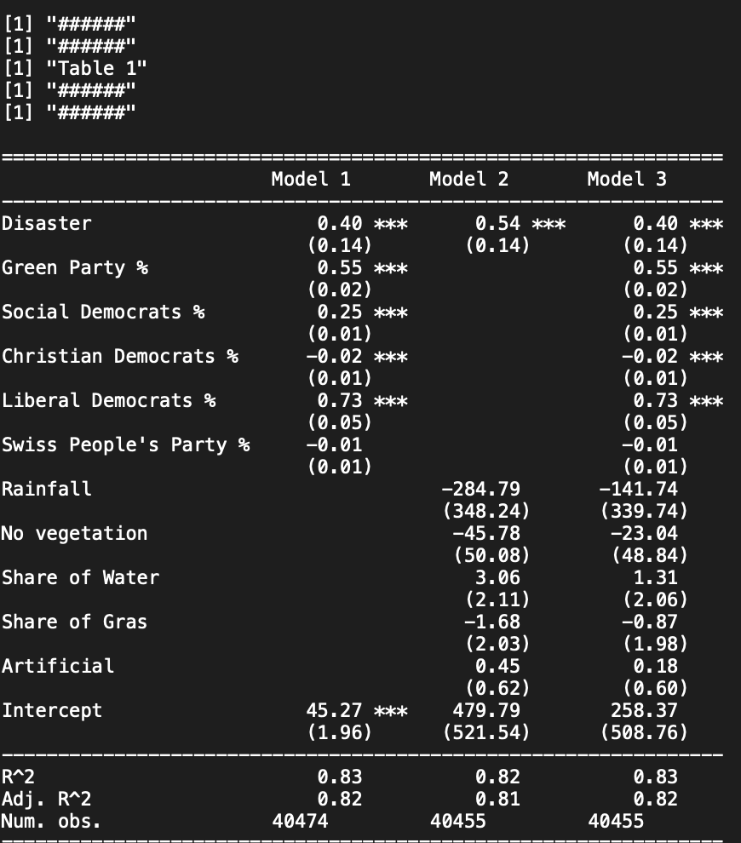
Leemann & Baccini 1995 – 2010
Keel 1995 – 2023

Slide 4
Interpretation
The summary is less effective than the one from leemann. The green party has more influence on average on the positive outcome.

Slide 5
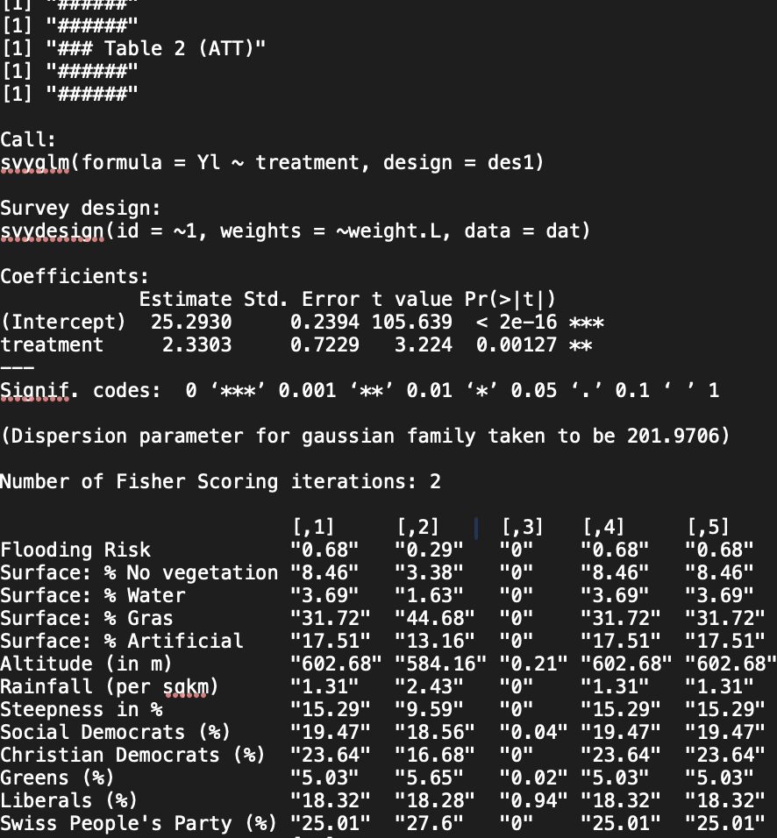
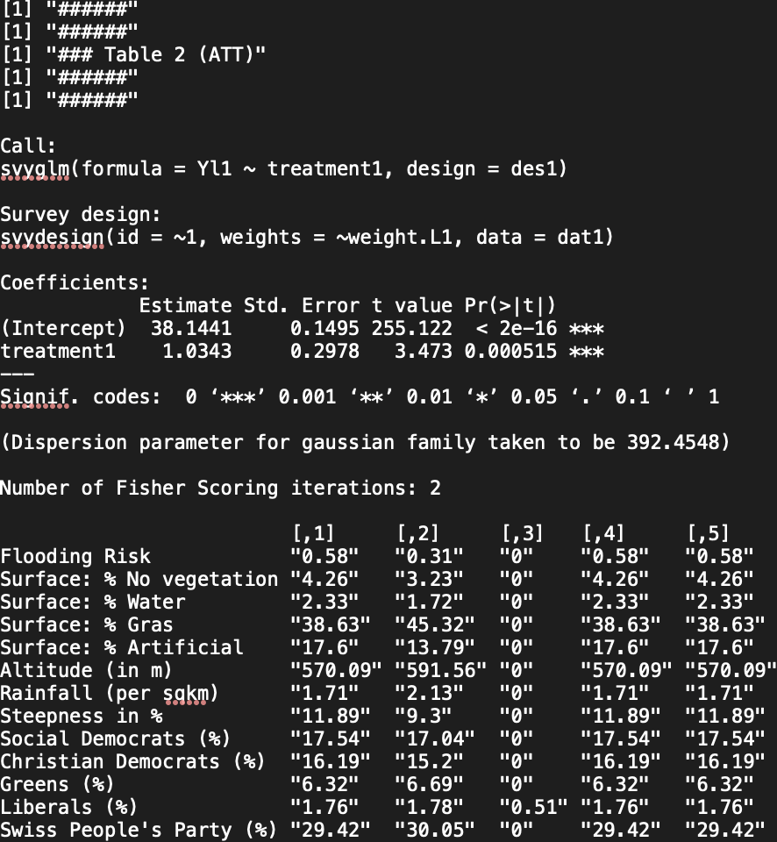
Leemann & Baccini 1995 – 2010
Keel 1995 – 2023

Slide 6
remarks
Balancing works

Slide 7
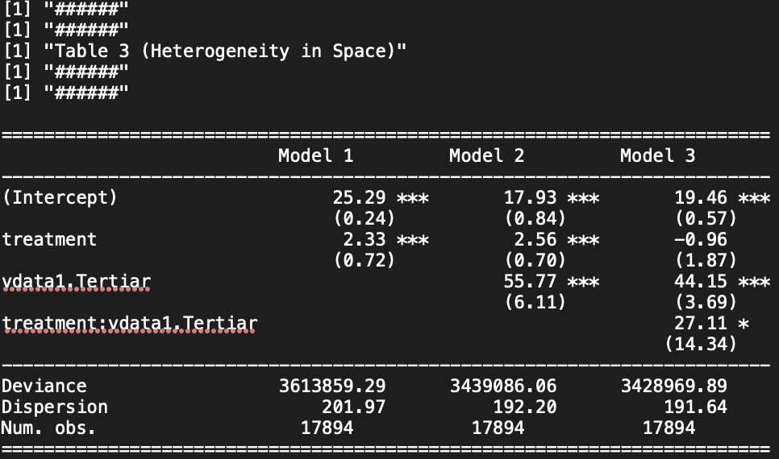
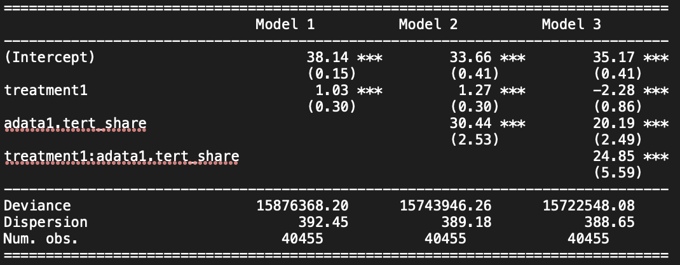
Leemann & Baccini 1995 – 2010
Keel 1995 – 2023

Slide 8
Interpretation
Entropy balanced model shows that more educated people in municipalities have greater positive impact on yes vote share when the municipality was affected. Nevertheless, the effect is smaller than in the previous study.

Slide 9
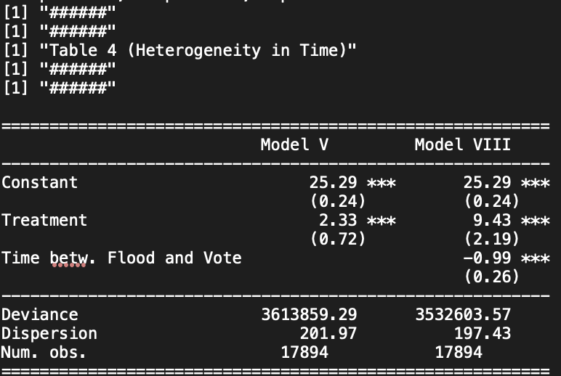
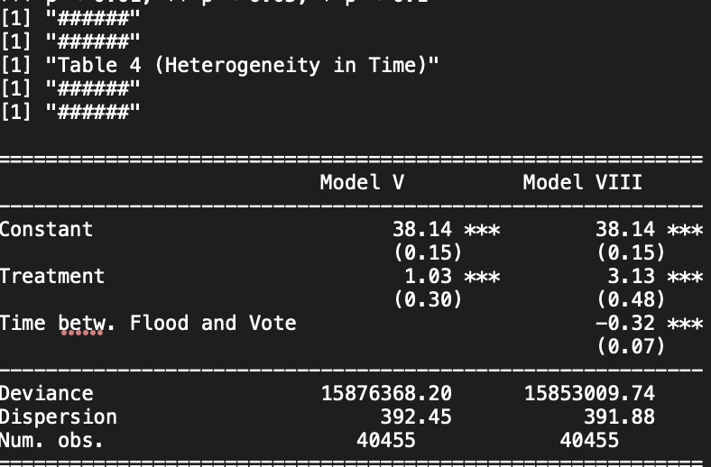
Leemann & Baccini 1995 – 2010
Keel 1995 – 2023

Slide 10
Interpretation
The effect is smalle and not 20(22.7%) as claimed by Leemann and Baccini but rather:
7.10%

Slide 11
New Variables
1995 – 2023
I am checking the new and/or more accurate variables within the disaster frame for the timerange 199%-2023

Slide 12
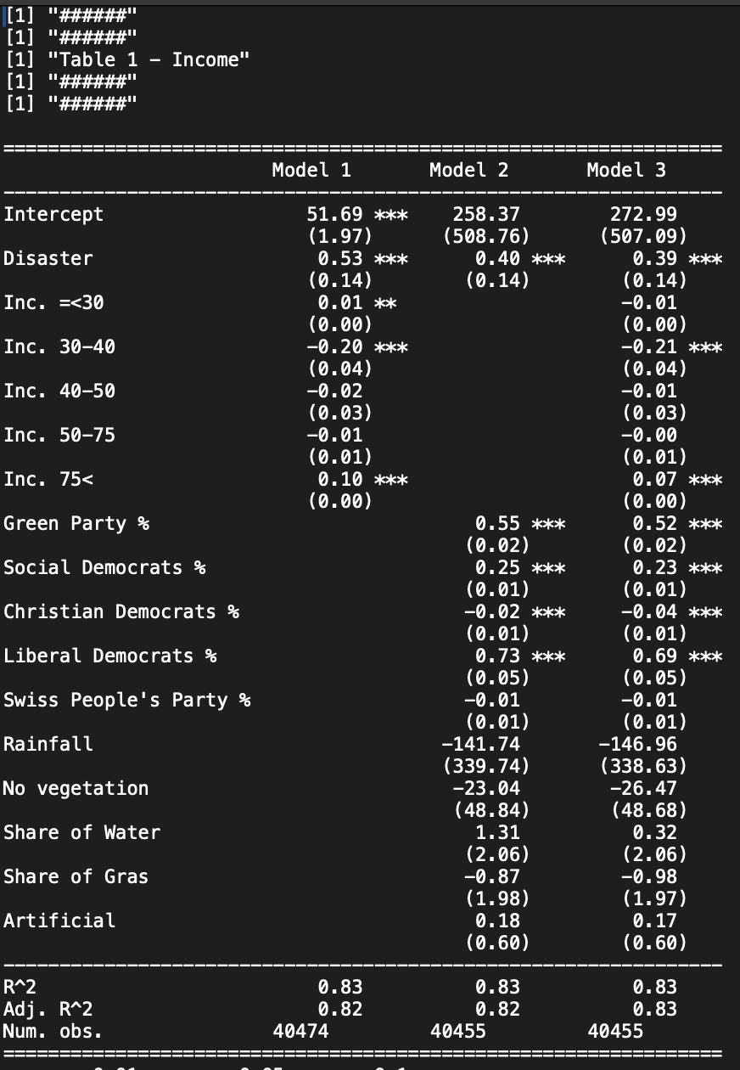

Slide 13
Interpretation
People with 30-40k gross net income tend to vote against pro environmental, even if affected.
People with 75k+ gross net income tend to vote pro environmental when affected.

Slide 14
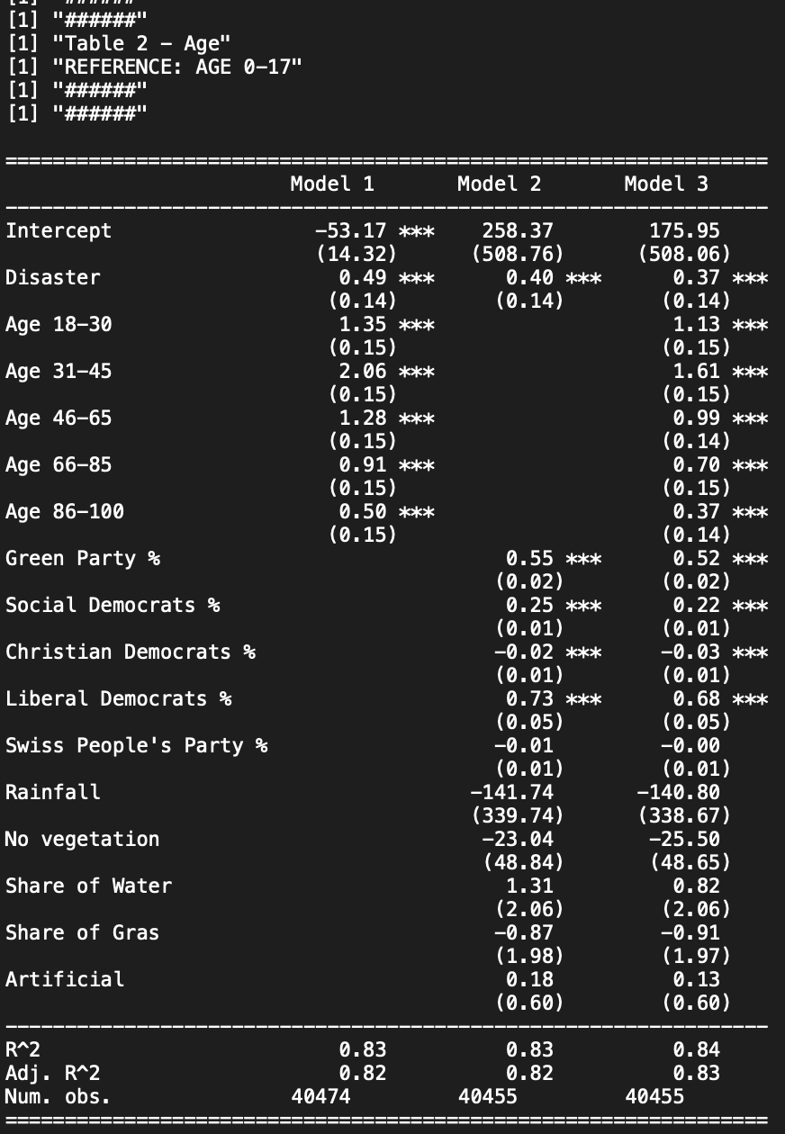

Slide 15
Interpretation
All age groups tend to have an impact on yes vote % when affected. Especially 31-45 year olds. The effect diminishes afterwards the older the people get.

Slide 16
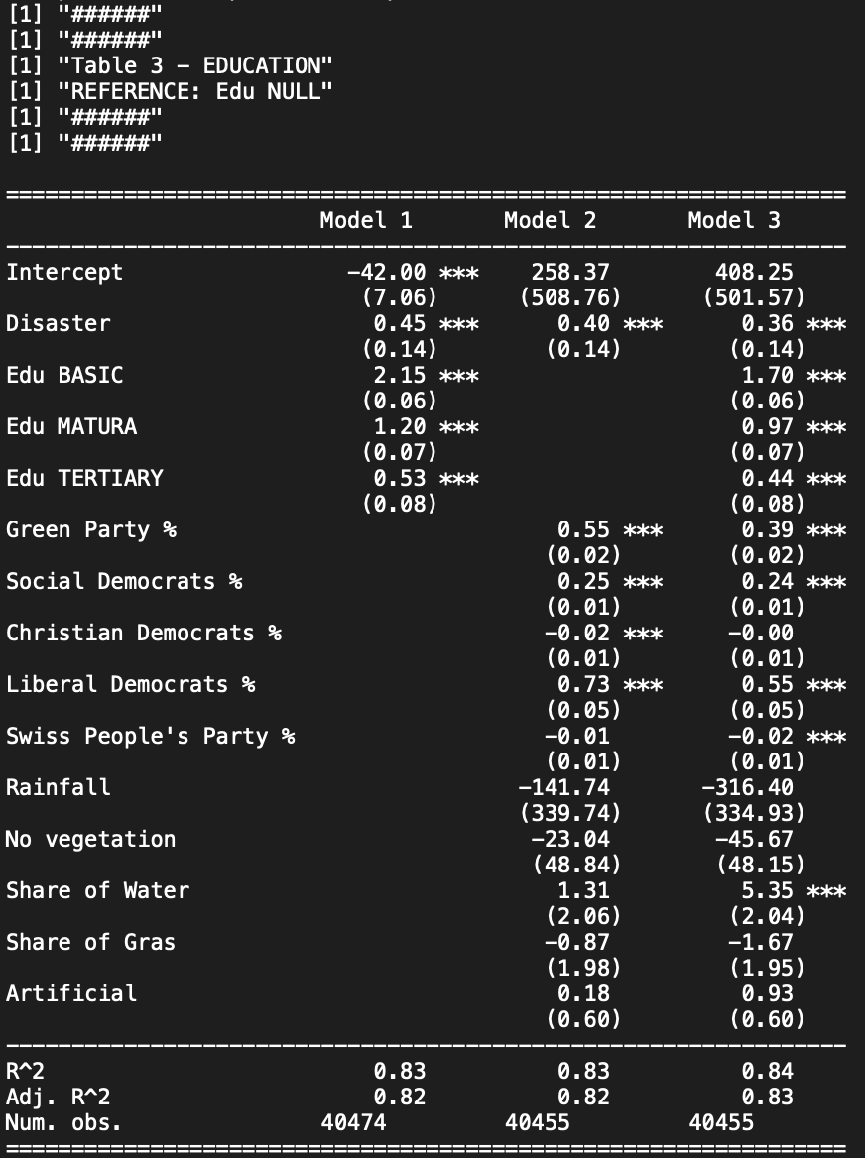

Slide 17
INterpretation
Edu Basic has the biggest positive effect in comparison to edu Null.
It is debatable, whether that can be linked with income, as it is counterintuitive.
Question: How to really interpret this?

Slide 18
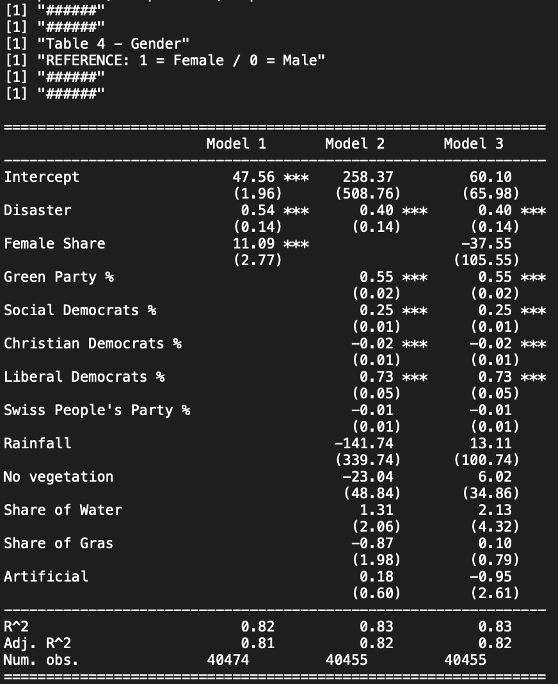

Slide 19
Interpretation
Gender has no effect

Slide 20
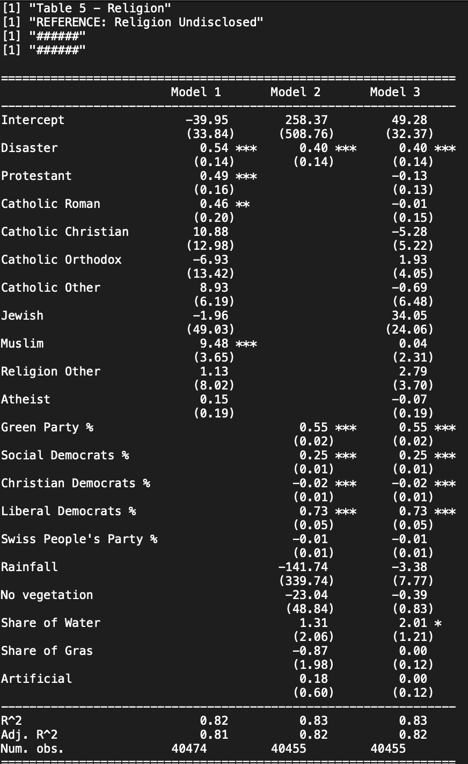

Slide 21
Religion
Religion has no effect

Slide 22
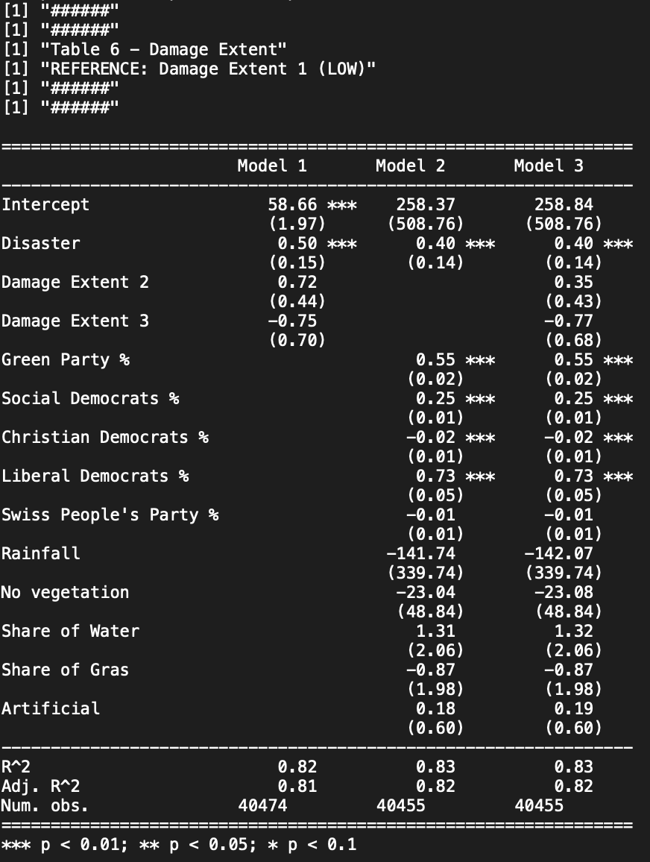

Slide 23
Interpretation
Damage extent Low, Medium, High has no effect – which supports my hypothesis, that not considering low damage events by Leemann & Baccini was not necessary.

Slide 24
New Variables
1995 – 2018 2018 – 2023
Reason for cutoff date:
Greta Thunbergs first Climate-Strike 2018-08-20
Checking whether there is a change because of more sensitivity due to climate demonstrations.

Slide 25
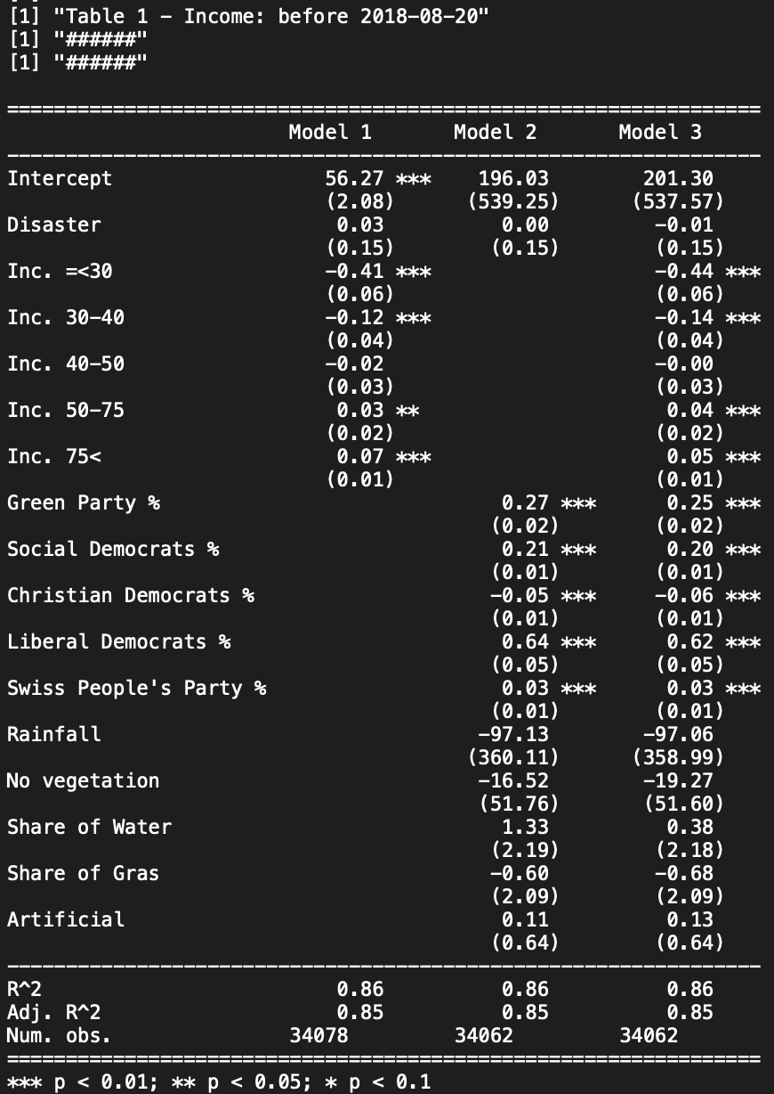
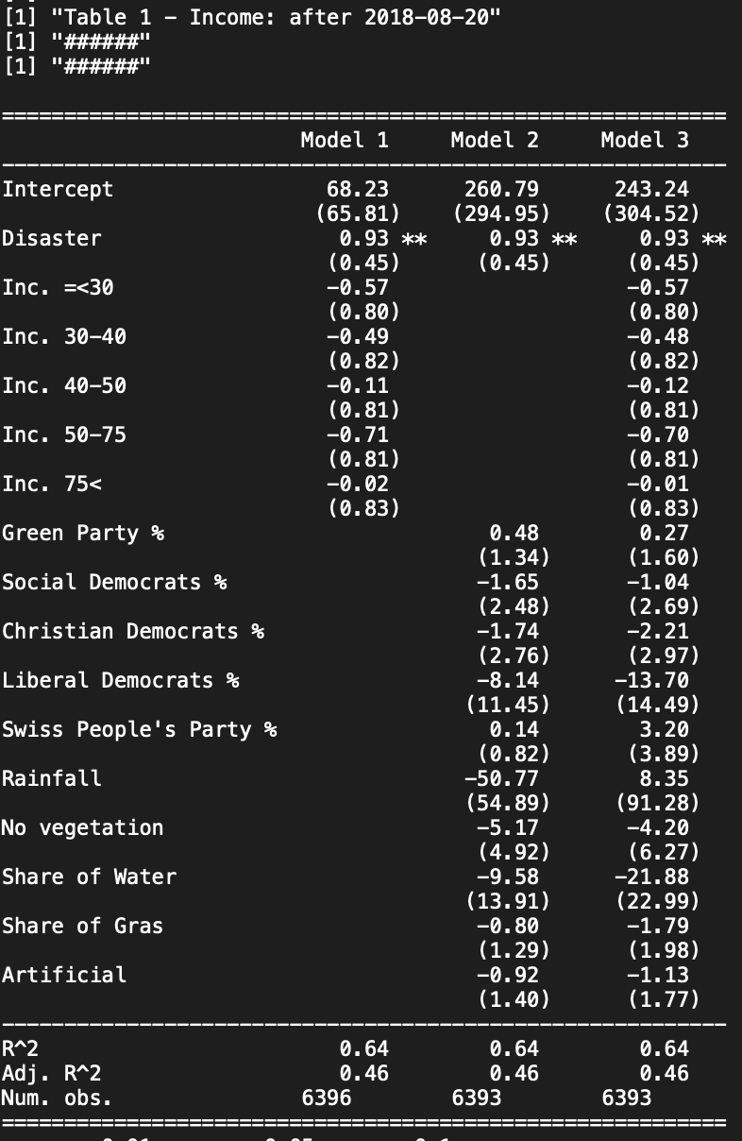

Slide 26
Interpretation
Before 2018 the Treatment/Disaster experience was not significant and green votes were solely dependable on income?
After 2018: only Treatment/Disaster experience is significant and affects yes vote share.

Slide 27
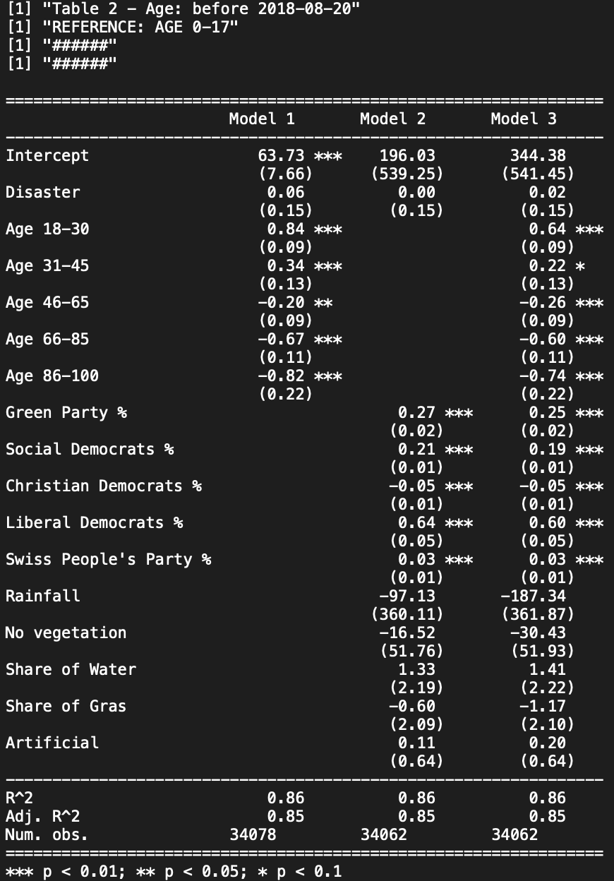
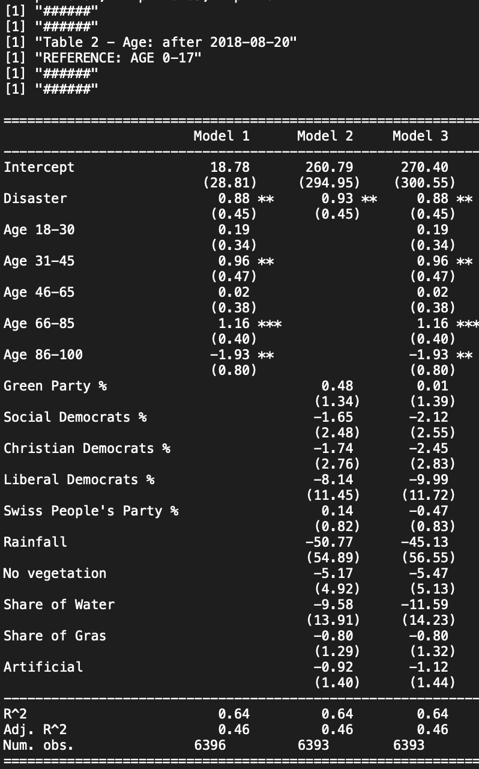

Slide 28
Interpretation
Before 2018 people in age groups would negatively affect the yes vote share.
After 2018: Most age groups would positively support yes vote share. Expect the oldest generation drastically increased the negative effect.

Slide 29
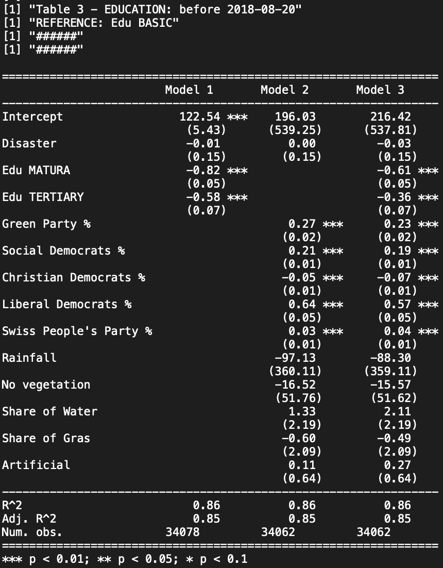
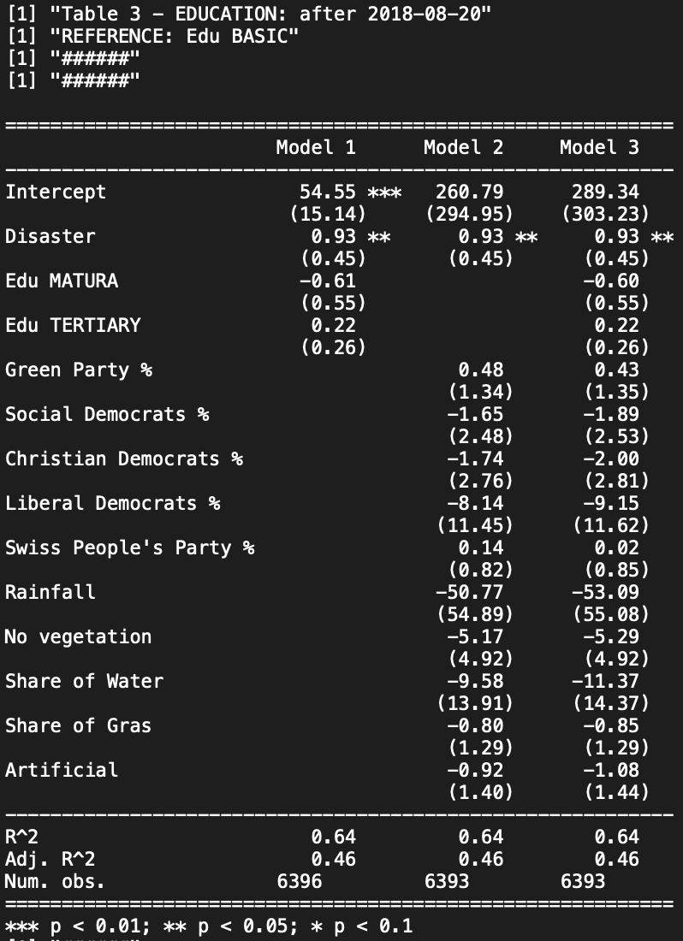

Slide 30
Interpretation
Before 2018: Educated people in general would have a negative effect on yes vote share if affected.
Stands in contradiction to findings with entropy balanced model…
After 2018: Education has no effect on yes vote share.
After 2018 reasoning makes sense, as obligatory education in Switzerland is quite thorough.

Slide 31
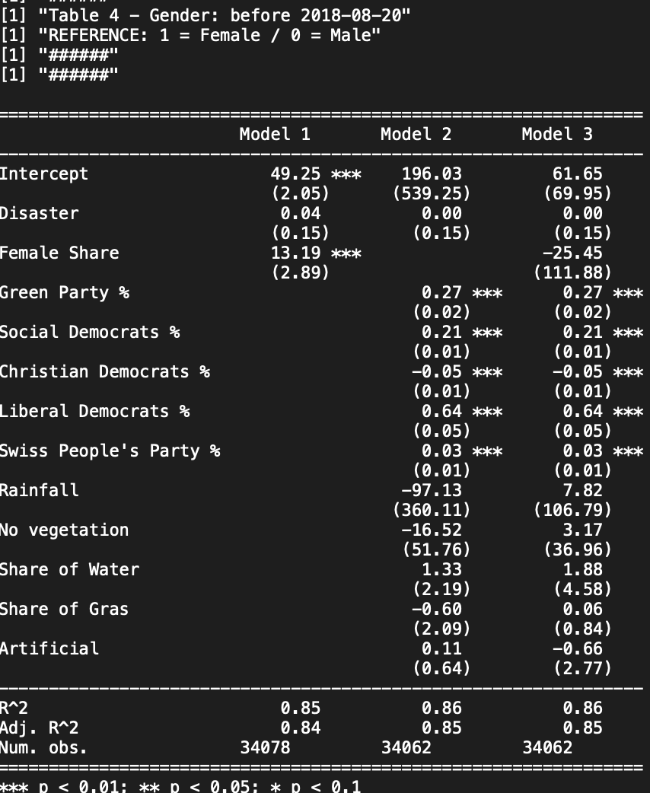
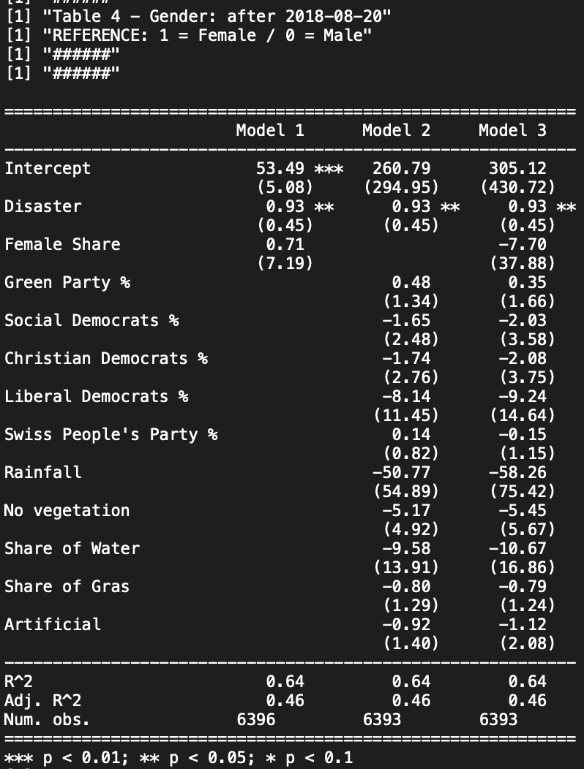

Slide 32
Remar
Gender: No change here

Slide 33
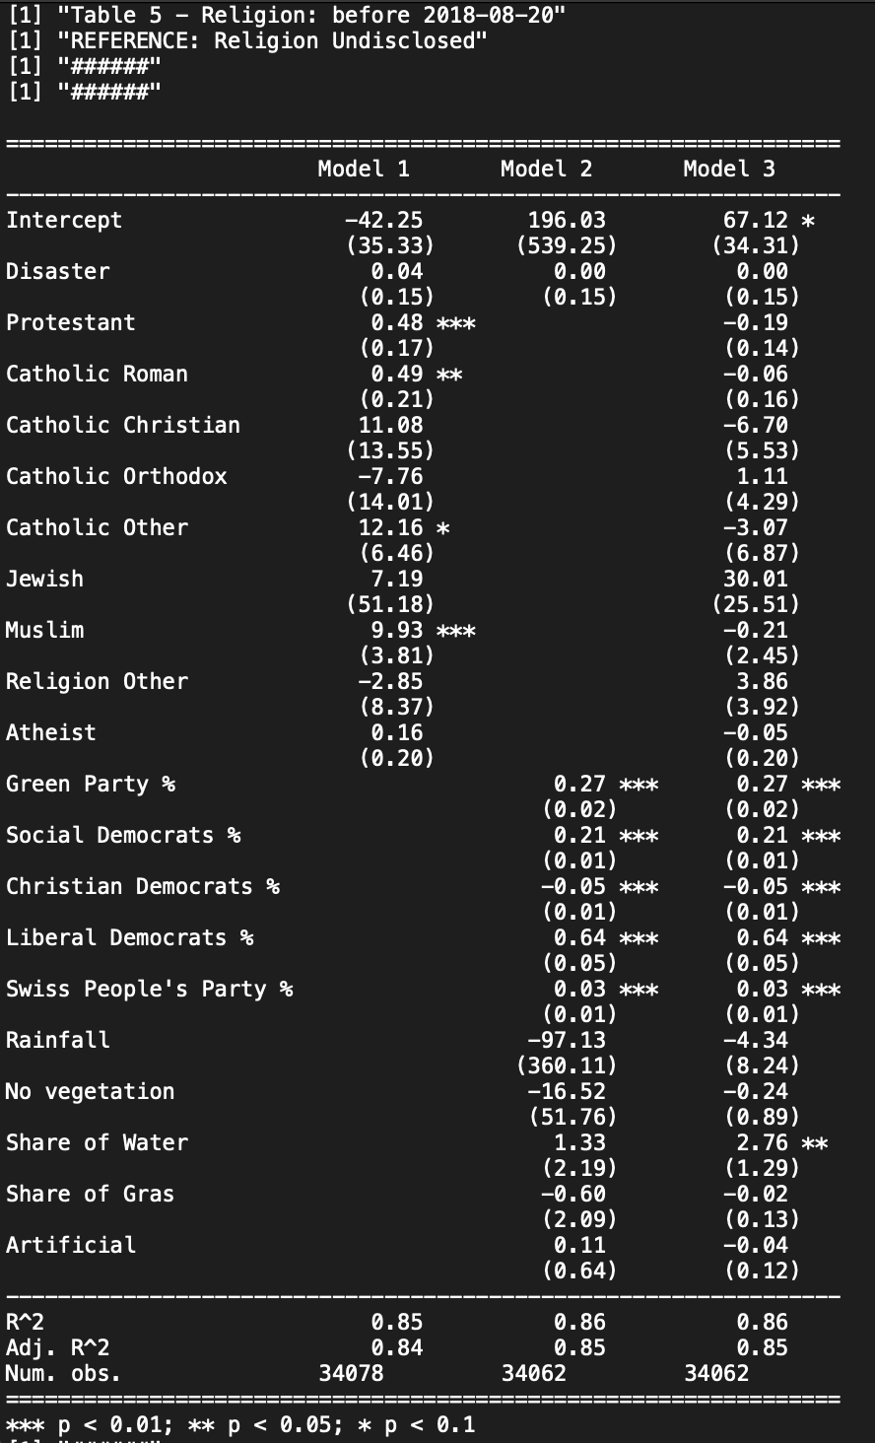
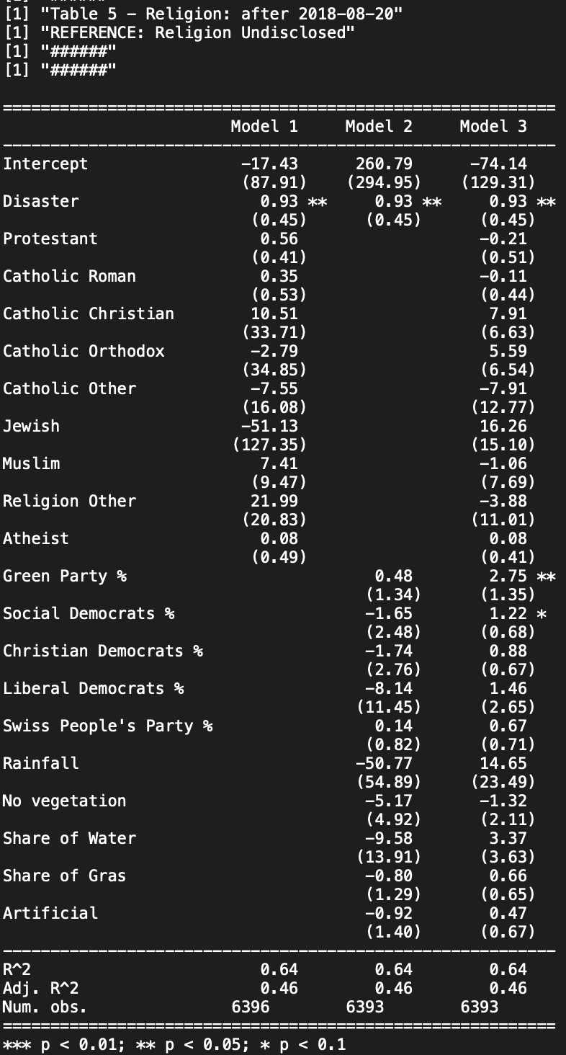

Slide 34
Remark
Religion: No change here

Slide 35
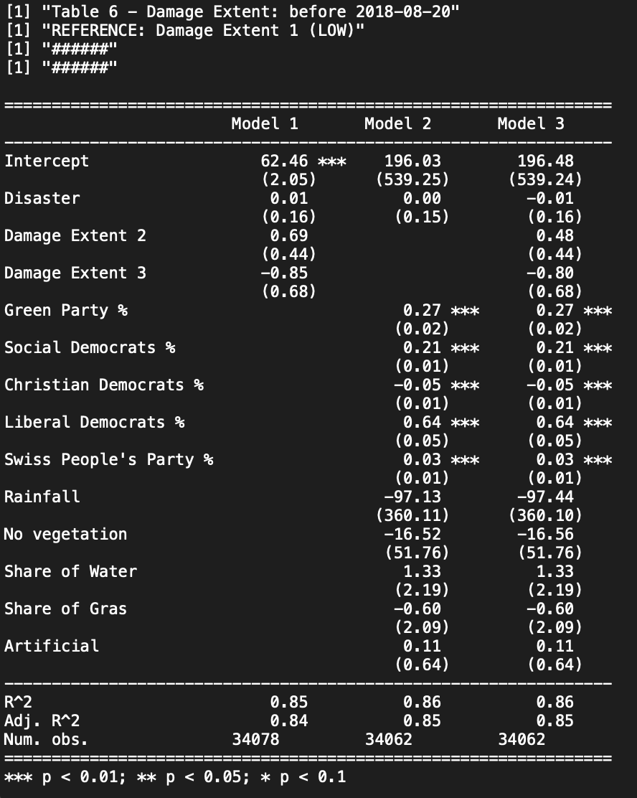
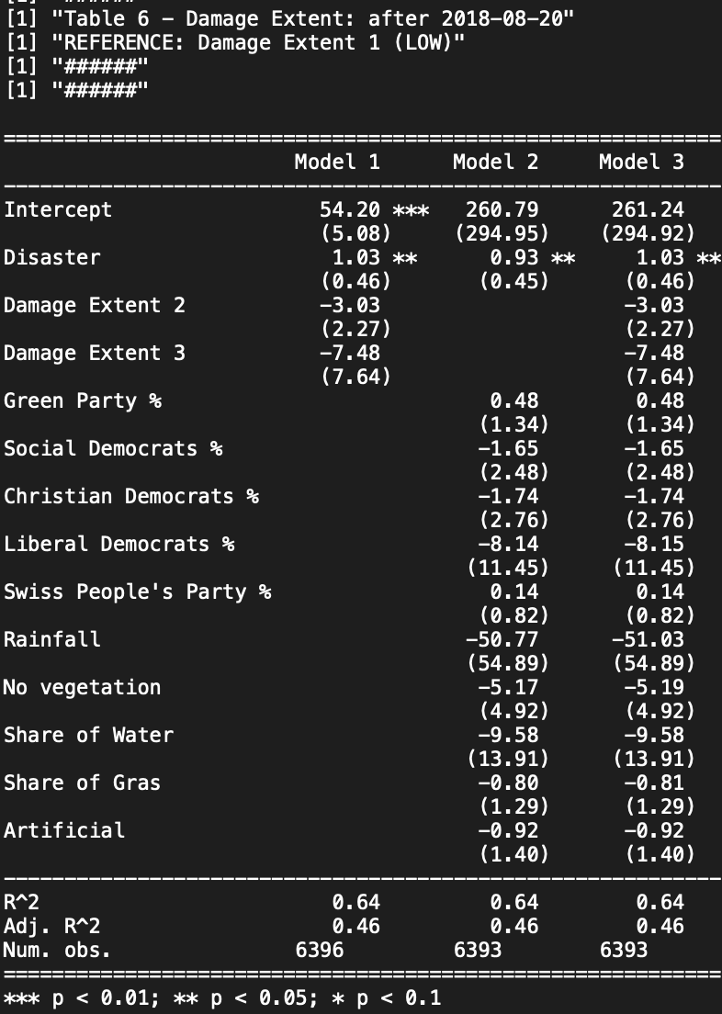

Slide 36
Remark
No change here

